Slide 1












UNIT I
Full Stack Development

Slide 2
Learning Resources
Books
A. Banks and E. Porcello, “Learning React: Functional Web Development with React and Redux”, O’Reilly, 1st Edition, 2017.
Web Links (Strictly Referred):
https://reactjs.org/
https://nodejs.org/
https://expressjs.com/
https://developer.mozilla.org

Slide 3
Introduction
Wikipedia
React is a free and open-source front-end JavaScript library for building user interfaces based on UI components. It is maintained by Meta (formerly Facebook) and a community of individual developers and companies.
Microsoft
React.js is the most popular front-end JavaScript framework. Developers use JSX, a combination of HTML and JavaScript, to create views in a natural way. Developers can also create components for blocks that can be reused across their applications. This module introduces React and the core skills developers need to use this powerful framework.

Slide 4
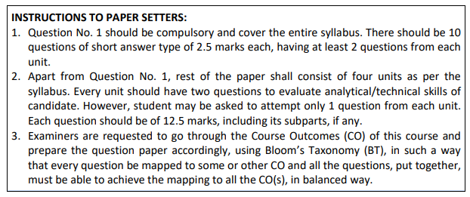
Learning Objectives
The core concepts of both the frontend and backend programming.
The latest web development technologies.
Maintaining data using NoSQL data bases.
Complete web application development process

Slide 5
Course Outcome
CO1: Relate the basics of Javascript (JS) and ReactJS
CO2: Apply the concepts of props and State Management in React JS
CO3: Examine Redux and Router with React JS
CO4: Appraise Node JS environment and modular development
CO5: Develop full stack applications using MongoDB

Slide 6
Overview
UNIT-1
Introduction to React
Obstacles and Roadblocks
React Library, React Developer tools
Introduction to ES6
Declaring variables in ES6, Arrow Functions, ES6 Objects and Arrays, ES6 modules
Introduction to AJAX
Pure React
Page setup, virtual DOM
React Element, React DOM, Constructing Elements with Data, React Components, DOM Rendering, First React Application using Create React App, React with JSX, React Element as JSX
Props, State and Component Tree
Property Validation, Validating Props with createClass, Default Props, ES6 Classes and stateless functional components, React state management, State within the component tree, state vs. props, Forms in React

Slide 7
Overview (cont..)
UNIT-2
Enhancing Components
Component Lifecycle, JavaScript library integration
Higher-Order Components, Managing state outside the react
Introduction to Flux
Redux and Router
State, Actions, Reducers, The Store
Middleware
React Redux
React Router, Incorporating the router, Nesting Router, Router parameters
JSON
Objects
Schema
REST API
WRML, REST API Design
Identifier Design with URIs, Interaction Design with HTTP, Representation Design, Caching, Security

Slide 8
Overview (cont..)
UNIT-3
Introduction to Angular
Angular architecture; introduction to components, component interaction and styles; templates, interpolation and directives; forms, user input, form validations; data binding and pipes; retrieving data using HTTP; Angular modules
Node.js
Introduction, Features, Node.js Process Model
Environment Setup: Local Environment Setup, The Node.js Runtime, Installation of Node.js
Node.js Modules: Functions, Buffer, Module, Modules Types
Node Package Manager: Installing Modules using NPM, Global vs Local Installation, Attributes of Package.js on, Updating packages, Mobile-first paradigm, Using twitter bootstrap on the notes application, Flexbox and CSS Grids
File System: Synchronous vs Asynchronous, File operations
Web Module: Creating Web Server, Web Application Architecture, Sending Requests, Handling http requests
Express Framework: Overview, Installing Express, Request / Response Method, Cookies Management

Slide 9
Overview (cont..)
UNIT-4
MongoDB:
Introduction to NoSQL
Understanding MongoDB datatypes
Building MongoDB Environment (premise and cloud based)
Administering Databases and User accounts
Configuring Access Control, Managing Collections
connecting to MongoDB from Node.js
Accessing and Manipulating Databases and Collections
Manipulating MongoDB documents from Node.js
Understanding Query objects,
sorting and limiting result sets

Slide 10
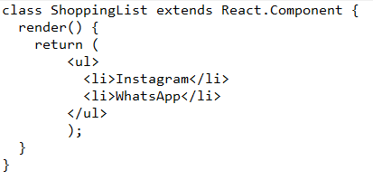
Introduction
React is a JavaScript library for building user interface
Declarative
Efficient
Flexible
Complex UIs Problem
Components
small and isolated pieces of code
use to tell React what will beon the screen
On every data change, update and re-render the component.
React has a few different kinds of components
Component
Takes some parameters called Properties (props).
Returns a hierarchy of views via render method
Render()
Returns a description to the client for presentation
Returns a react element, a lightweight element
Use a special syntax called “JSX” which makes these structures easier to write

Slide 11
Introduction
Node.js is an open-source and cross-platform JavaScript runtime environment to create all kinds of server-side tools and applications
Node.js runs the V8 JavaScript engine, the core of Google Chrome, outside of the browser
JavaScript is a programming language that was created at Netscape as a scripting tool to manipulate web pages inside their browser
Netscape was to sell Web Servers, called Netscape LiveWire.
create dynamic pages using server-side JavaScript (FAILURE)
Web 2.0 applications (such as Flickr, Gmail, etc.) that showed the world what a modern experience on the web could be like
2009: Node.js is born
2010:
Socket.io: Socket.IO is a library that enables low-latency, bidirectional and event- based communication between a client and a server.
Express: Fast, unopinionated, minimalist web framework for Node.js
2011: Hapi: Build powerful, scalable applications, with minimal overhead

Slide 12
Introduction
2013
First big blogging platform using Node.js: Ghost
Koa is born
2014:
The Big Fork: io.js is a major fork of Node.js, with the goal of introducing ES6 support and moving faster
2015:
The Node.js Foundation is born
IO.js is merged back into Node.js
npm introduces private modules
Node.js 4 (versions 1, 2 and 3 never previously released)
2016:
The leftpad incident
Yarn is born
Node.js 6
2017:
npm focuses more on security, HTTP/2
V8 introduces Node.js in its testing suite, officially making Node.js a target for the JS engine, in addition to Chrome

Slide 13
Introduction
Express is the most popular Node web framework, and is the underlying library for a number of other popular Node web frameworks
Write handlers for requests with different HTTP verbs at different URL paths (routes).
Integrate with "view" rendering engines in order to generate responses by inserting data into templates.
Set common web application settings like the port to use for connecting, and the location of templates that are used for rendering the response.
Add additional request processing "middleware" at any point within the request handling pipeline.
MongoDB
Open source No-SQL Database
Light weighted, useful for working with large sets of distributed data.
Contains a structure of data, composed of field (key) and value pairs
Similar to JSON, called Binary JSON.
Sets of these documents are called collections, like table in relational DB

Slide 14
Full Stack Development
Software development has three main layers :
Frontend or Presentation layer
Backend or Business layer
Database layer
MERN (React)
MEAN (Angular)
LAMP (Apache)
LEMP (nginX)
Full-Stack Elixir
Full-Stack Python
Full-Stack Django
Full-Stack Java
Full-Stack Ruby on Rails

Slide 15
Full Stack Development
Full-Stack Developers can do the following:
Ability to code programs, web applications, or mobile applications.
Coordinate the development process with other developers and team members (including product managers, project managers, and C-level executives).
Troubleshoot technical issues at every layer.
Outline testing techniques for various applications.
Analyzing and debugging database queries.
Testing codes for app validation and compatibility across required devices for quality assurance.
Keeping a tab on important KPIs and taking initiatives as needed.
Laying blueprint for future requirements and communicating the same with upper management.

Slide 16
Full Stack Development
Roles:
Tech Lead (or CTO)
Product Manager
Database Administrator
Senior Developer
Benefits:
Delegate Everything Technical
Make the Team Flexible
Cost-Effectiveness

Slide 17
Full Stack Development
Skill Set and Qualification required:
Front-end fundamentals
Server-side fundamentals
User Experience design
Database architecture and design
Business Logic
Project Management
Multitasking
Agile Development
Independence

Slide 18
Obstacles and Roadblocks
React Is a Library
Small
Used for one part of job
Restricted than traditional JavaScript
New tools emerged and old are cast aside
New ECMAScript Syntax
The ECMA used to release specifications infrequently
Popularity of Functional JavaScript
React emphasizes functional programming over object-oriented programming
JavaScript Tooling Fatigue
Conventional JavaScript added into your source page
In react you have to built JavaScript

Slide 19
React Library
Routing and Navigation in Reactjs
React Router : a group of navigational components synchronizes the components of the UI with browsers address
React CLIs and Boilerplates
Create-React-App: Create-React-App is a CLI tool that requires no building configuration
React UI Component Libraries
Ant-design: a consolidated development framework of NPM, Webpack, Babel, Dora, and DVA
Tailwind UI: utility classes (in-built classes) instead of inbuilt components that relieves you from overriding styles
Semantic UI React
React Bootstrap
Fabric React
Styled components
React DnD

Slide 20
React Library
Notable UI libraries
OnsenUI
Rebass
Material UI
Animation Libraries
React-motion
Animated (React Native)
React Spinner
Form Libraries
React Hook Form

Slide 21
React Library
Code formatting
ES-Lint
React Intl
Prettier
Testing
Enzyme
State Management
Redux
Mobx
Augment Reality/ Virtual Reality (AR/ VR)
React 360
Viro React

Slide 22
React Developer Tools
react-detector
react-detector is a Chrome extension that lets you know which websites are using React and which are not.
show-me-the-react
This is another tool, available for Firefox and Chrome, that detects React as you browse the internet.
React Developer Tools
This is a plugin that can extend the functionality of the browser’s developer tools. It creates a new tab in the developer tools where you can view React elements.
Source: https://youteam.io/blog/full-stack-software-developer-hiring/

Slide 23
Introduction of ES6
ECMA Script 6 (ES6):
ECMA Script 2015
based on specification and standardization by ECMA International Company
ES6 is the ECMA script programming language
used to create the standards for JavaScript language such that it can bring multiple independent implementations.
ES6 converted into the production server code, bundled, and minifies with webpack using Babel compiler.

Slide 24
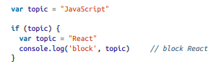
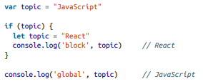
Introduction of ES6
const: variable that cannot be changed.
let: JavaScript now has lexical variable scoping.
Template Strings: an alternative to string concatenation
Traditional string concatenation uses plus signs:
With a template, we can create one string and insert the variable values by surrounding them with ${ }:

Slide 25

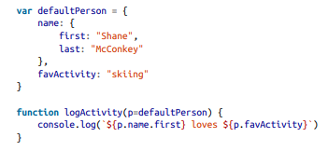
Introduction of ES6
Default Parameters: a value is not provided for the argument, the default value will be used

Slide 26

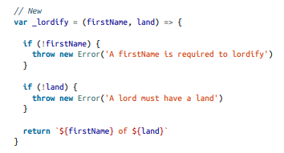

Introduction of ES6
Arrow Functions: create functions without using the function keyword
Less Code
Optimized
Faster than traditional function

Slide 27
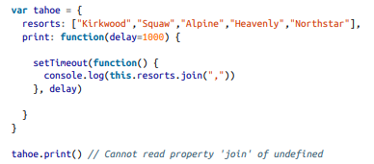
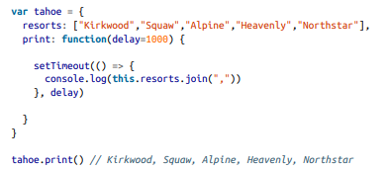
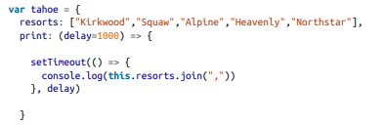

Introduction of ES6
Arrow Functions: create functions without using the function keyword

Slide 28
Introduction of ES6
Transpiling ES6
all web browsers support ES6
Transpiling is a process to convert ES6 code to ES5 before running it in the browser.
In past any update in JavaScript, force to wait till weeks or months until the browser update themselves to adapt the new version of JavaScript.
Transpiling is not compiling: our code isn’t compiled to binary
transpiled into syntax that can be interpreted by a wider range of browsers
JavaScript now has source code, meaning that there will be some files that belong to your project that don’t run in the browser

Slide 29

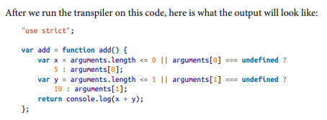
Introduction of ES6
Transpiling Example
transpiler added a “use strict” declaration to run in strict mode

Slide 30

ES6 Objects and Arrays
JavaScript data types and data structures
Dynamic typing
JavaScript is a loosely typed and dynamic language
Variables in JavaScript are not directly associated with any particular value type, and any variable can be assigned (and re-assigned) values of all types

Slide 31
ES6 Objects and Arrays
JavaScript data types and data structures
JavaScript types
Primitive values (immutable datum represented directly at the lowest level of the language)
Boolean type
Null type
Undefined type
Numeric type
Number type
BigInt type
NaN type
String type
Objects (collections of properties)

Slide 32
ES6 Objects and Arrays
JavaScript data types and data structures
Object Type
is a value in memory which is possibly referenced by an identifier
can be seen as a collection of properties
a limited set of properties are initialized; then properties can be added and removed
Property values can be values of any type, including other objects, which enables building complex data structures
Properties are identified using key values
A key value is either a String value or a Symbol value.

Slide 33
ES6 Objects and Arrays
Object Type
two types of object properties
data property
Associates a key with a value, and has the following attributes:
Attribute | Type | Description | Default value
[[Value]] | Any JavaScript type | The value retrieved by a get access of the property. | undefined
[[Writable]] | Boolean | If false, the property's [[Value]] cannot be changed. | false
[[Enumerable]] | Boolean | If true, the property will be enumerated in for...in loops. | false
[[Configurable]] | Boolean | If false, the property cannot be deleted, cannot be changed to an accessor property, and attributes other than [[Value]] and [[Writable]] cannot be changed. | false

Slide 34
ES6 Objects and Arrays
Object Properties
Accessor property
Associates a key with one of two accessor functions (get and set) to retrieve or store a value.
Attribute | Type | Description | Default value
[[Get]] | Function object or undefined | The function is called with an empty argument list and retrieves the property value whenever a get access to the value is performed. See also get. | undefined
[[Set]] | Function object or undefined | The function is called with an argument that contains the assigned value and is executed whenever a specified property is attempted to be changed. See also set. | undefined
[[Enumerable]] | Boolean | If true, the property will be enumerated in for...in loops. | false
[[Configurable]] | Boolean | If false, the property can't be deleted and can't be changed to a data property. | false

Slide 35
ES6 Objects and Arrays
Indexed collections: Arrays and typed Arrays
Arrays are regular objects for which there is a particular relationship between integer-keyed properties and the length property
arrays inherit from Array.prototype, which provides to them a handful of convenient methods to manipulate arrays e.g. IndexOf(), Push() etc.
a perfect candidate to represent lists or sets
Typed Arrays are new to JavaScript with ECMAScript 2015, and present an array-like view of an underlying binary data buffer

Slide 36
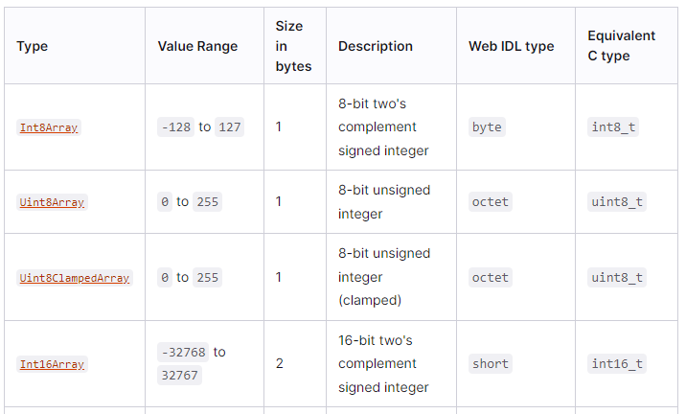
ES6 Objects and Arrays
Typed Arrays
[Source: https://developer.mozilla.org/en-US/docs/Web/JavaScript/Data_structures]

Slide 37

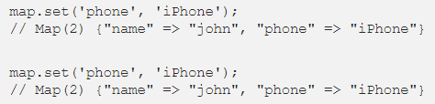

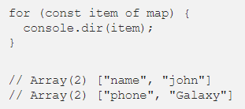
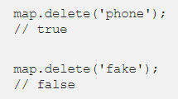
ES6 Objects and Arrays
Keyed collections: Maps, Sets, WeakMaps, WeakSetsArrays
Set and WeakSet represent a set of objects, while Map and WeakMap associate a value to an object.
Map
A Map is a new collection object in JavaScript that functions like an object.
Map is an iterable object
remove properties from object

Slide 38
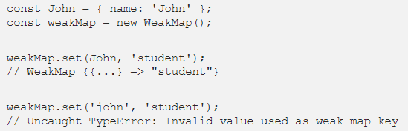
ES6 Objects and Arrays
WeakMaps :WeakMap originated from Map, so they are very similar to each other
Differences
The key must be an object
Not all methods from Map are supportive (support only)
delete()
get()
has()
set()

Slide 39
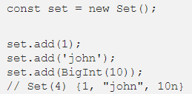
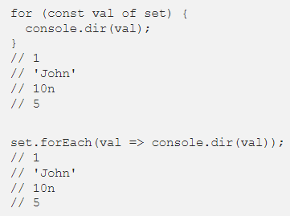
ES6 Objects and Arrays
Set is also quite similar to Map, but Set is more useful for a single value
Add Properties to Set
Set is an iterable object, you can use a for-of or forEach statement

Slide 40
ES6 Objects and Arrays
Set is also quite similar to Map, but Set is more useful for a single value
Add Properties to Set
Set is an iterable object, you can use a for-of or forEach statement

Slide 41
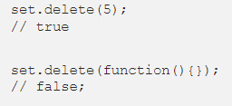
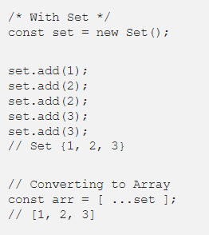
ES6 Objects and Arrays
Set is also quite similar to Map, but Set is more useful for a single value
remove Properties
Set to array conversion

Slide 42
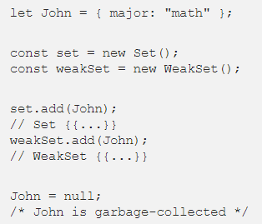
ES6 Objects and Arrays
WeakSet loses the access link to inner data if they’re garbage-collected

Slide 43
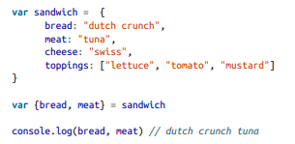
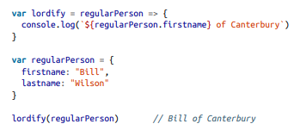
Some Important Topics
Destructuring Assignment : allows you to locally scope fields within an object and to declare which values will be used

Slide 44

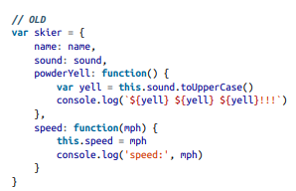
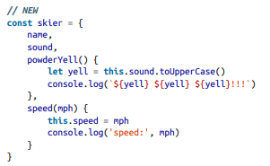
Some Important Topics
Object Literal Enhancement: the process of restructuring or putting back together or opposite of destructuring

Slide 45



Some Important Topics
The Spread Operator (… three dots):
spread operator allows us to combine the contents of arrays

Slide 46
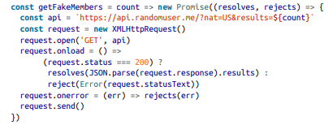
Some Important Topics
Promises:
Promises give us a way to make sense out of asynchronous behavior
When making an asynchronous request, one of two things can happen: everything goes as we hope or there’s an error
Promises give us a way to simplify back to a simple pass or fail.

Slide 47



ES6 Modules
A JavaScript module is a piece of reusable code that can easily be incorporated into other JavaScript files
There are two options when creating and exporting a module: you can export multiple JavaScript objects from a single module, or one JavaScript object per module

Slide 48
AJAX
Asynchronous JavaScript And XML (AJAX)
use of the XMLHttpRequest object to communicate with servers
send and receive information in various formats, including JSON, XML, HTML, and text files
Nature is asynchronous
two major features of AJAX
Make requests to the server without reloading the page
Receive and work with data from the server

Slide 49
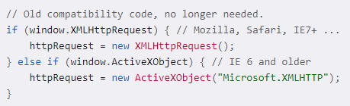

Step 1 – How to make an HTTP request
To make an HTTP request to the server with JavaScript
Create instance of XMLHttpRequest
After making a request, you will receive a response back and tell the XMLHttp request object which JavaScript function will handle the response, by setting the onreadystatechange property of the object

Slide 50
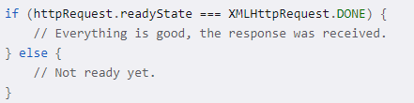
Step 2 – Handling the server response
When you sent the request, you provided the name of a JavaScript function to handle the response, the function needs to check the request's state
readyState values
0 (uninitialized) or (request not initialized)
1 (loading) or (server connection established)
2 (loaded) or (request received)
3 (interactive) or (processing request)
4 (complete) or (request finished and response is ready)

Slide 51
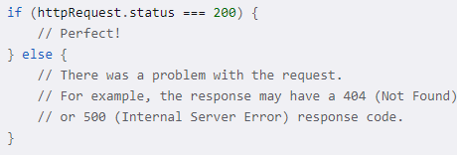
Step 2 – Handling the server response
When you sent the request, you provided the name of a JavaScript function to handle the response, the function needs to check the request's state
readyState values
0 (uninitialized) or (request not initialized)
1 (loading) or (server connection established)
2 (loaded) or (request received)
3 (interactive) or (processing request)
4 (complete) or (request finished and response is ready)

Slide 52
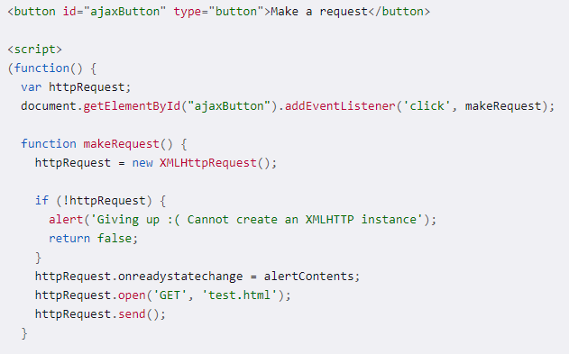
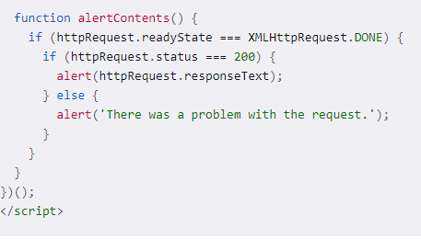
Example

Slide 53



Working with the XML response
test.xml contains the following:

Slide 54

Page Setup
two libraries required
React :
React is a JavaScript library for building user interfaces
you can use as little or as much React as you need
ReactDOM
The react-dom package provides DOM-specific methods that can be used at the top level of your app and as an escape hatch to get outside the React model if you need to.
The react-dom package also provides modules specific to client and server apps:
react-dom/client
react-dom/server

Slide 55
Virtual DOM
DOM (Document Object Model)
document structure, style, and content
A web page is a document
As an object-oriented representation of the web page, it can be modified with a scripting language such as JavaScript
The virtual DOM (VDOM) is a programming concept
where an ideal, or “virtual”, representation of a UI is kept in memory
synced with the “real” DOM by a library such as ReactDOM
VDOM ensure the DOM matches the state, if developer change the state
attribute manipulation
event handling
manual DOM updating
VDOM is usually associated with React elements
React internal objects “fiber” hold the additional information about the component tree [React Fiber more details: https://github.com/acdlite/react-fiber-architecture]

Slide 56
Virtual DOM
Shadow DOM
The Shadow DOM is a browser technology
primarily designed for scoping variables and CSS in web components
More differences between Shadow DOM and Virtual DOM
[Source: https://www.geeksforgeeks.org/what-is-the-difference-between-shadowdom-and-virtualdom/]
Virtual DOM | Shadow DOM
It revolves around solving performance issues. | It revolves around the concept of encapsulation.
It is a complete representation of an actual DOM. | It is not a complete representation of the entire DOM.
It groups together several changes and does a single re-render instead of many small ones. | It adds a subtree of DOM elements into the rendering of a document, instead of adding it to the main document’s DOM tree.
It creates a copy of the whole DOM object. | It creates small pieces of the DOM object having their own, isolated scope.
It does not isolate the DOM. | It isolates the DOM.
It does not help with CSS scoping. | It helps with CSS scoping.

Slide 57
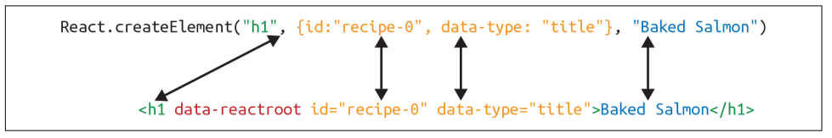
React Elements
React DOM is made up of React
React elements are the instructions for how the browser DOM should be created
Create a React element
first argument defines the type of element
second argument represents the element’s properties
third argument represents the element’s children

Slide 58
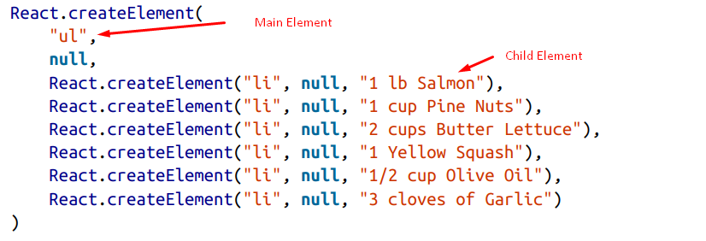
ReactDOM
ReactDOM contains the tools necessary to render React elements in the browser
ReactDOM is where we will find the render method as well as the renderToString and renderToStaticMarkup methods
Children

Slide 59
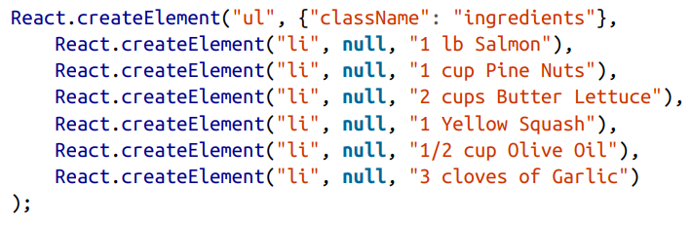
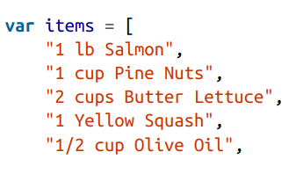

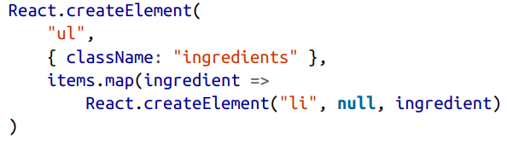

ReactDOM
Constructing Elements with Data

Slide 60
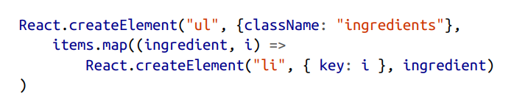
ReactDOM
Constructing Elements with Data

Slide 61
React Components
Reduce the complexities of UI
re-use the same DOM for different purpose or different sets of data
Identify the react components
Try to break down your elements into reusable pieces
How scalable it is?
How to create a Component?
In 2013, React.createClass

Slide 62
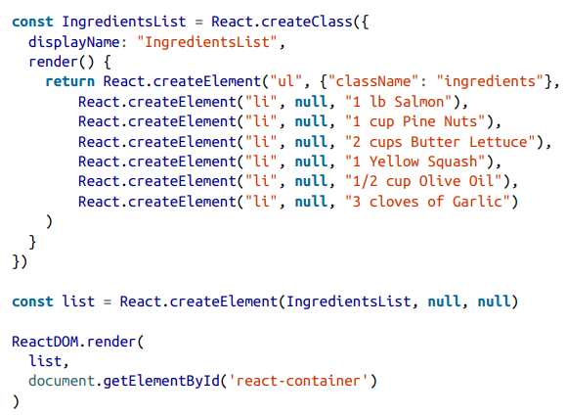
React Components

Slide 63
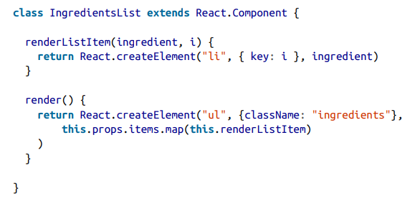
React Components
Create Components
React.Component

Slide 64
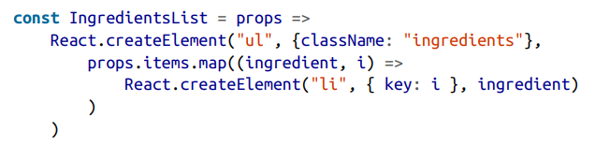
React Components
Stateless Functional
Stateless functional components are functions, not objects
Don’t have “this” scope
Pure functions, we can use as much as possible
Stateless functional components are functions that take in properties and return a DOM element
keep your application architecture simple
Not in use to encapsulate functionality or have a this scope

Slide 65
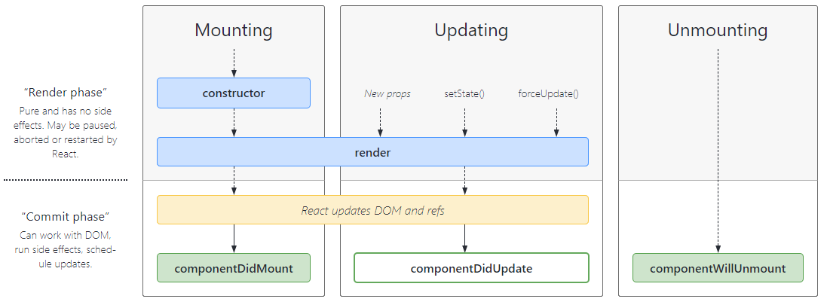
React Component Lifecycle
The Component Lifecycle
[Source: https://projects.wojtekmaj.pl/react-lifecycle-methods-diagram/]

Slide 66
React Component Lifecycle
The Component Lifecycle
Mounting : called in the following order when an instance of a component is being created and inserted into the DOM
constructor()
static getDerivedStateFromProps()
render()
componentDidMount()

Slide 67
React Component Lifecycle
Updating : called in the following order when a component is being re-rendered
static getDerivedStateFromProps()
shouldComponentUpdate()
render()
getSnapshotBeforeUpdate()
componentDidUpdate()
Unmounting
componentWillUnmount()
Error Handling
static getDerivedStateFromError()
componentDidCatch()

Slide 68

DOM Rendering
Using react we are able to pass data to our components as props
Isolate the application’s data from the logic, used to create UI
In change of any isolated data, change the state
Plan to make a light weighted components to lighten the process of component render.
For the heavy lift of DOM component, react works smartly and make only the minimal required changes to optimize the processing time.

Slide 69
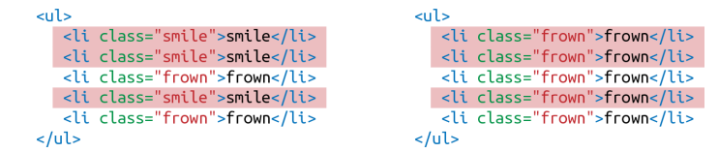
DOM Rendering
How we can update the DOM to reflect these changes?
Inefficient solution
Empty the current data
Begin looping through data and build the first list item
Build and add the second list item
Build and append the third list item
.. And so on
ReactDOM.render makes changes by leaving the current DOM in place and simply updating the DOM elements that need to be updated

Slide 70


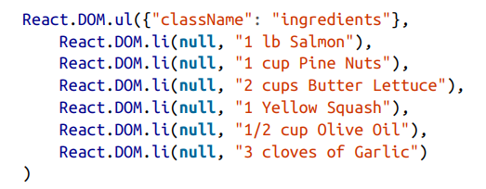
Factories
Another way to create a React element is to use factories
A factory is a special object that can be used to abstract away the details of instantiating objects
React has built-in factories for all commonly supported HTML and SVG DOM elements

Slide 71
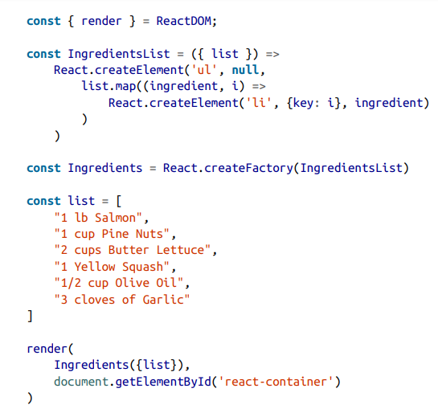
Using Factories with Components

Slide 72
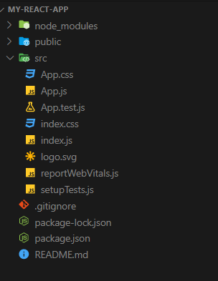
Steps to create first reactjs app
Install NVM
https://github.com/coreybutler/nvm-windows
Install NodeJS
https://nodejs.org/en/download/
Command to check node version
node --version
npm --version
To create first app
npx create-react-app my-react-app

Slide 73
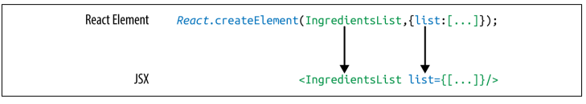
React Elements as JSX
JSX, a simpler way to creating complex DOM trees with attributes
JSX is as readable as HTML, XML
JSX elements can be added as children
Array of the elements can be pass into JSX

Slide 74
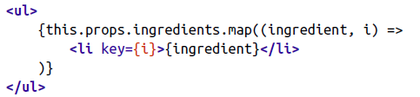
React Elements as JSX
Nested components
className
JavaScript expressions
Evaluation
Mapping arrays to JSX

Slide 75
Babel
To transpile code in the browser, use Babel v. 5.8.
Babel 6.0+ will not work as an in-browser transformer.
transpile our code from JSX to pure React, Babel will also convert ES6 into common ES5 JavaScript that is readable by all browsers
Babel Presets
babel-preset-es2015
babel-preset-env
babel-preset-react

Slide 76
Props, State, and the Component Tree

Slide 77

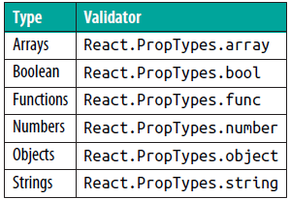
Property Validation
JavaScript is a loosely typed language
React components provide a way to specify and validate property types
reduce the amount of time spent debugging
incorrect property types triggers warnings

Slide 78

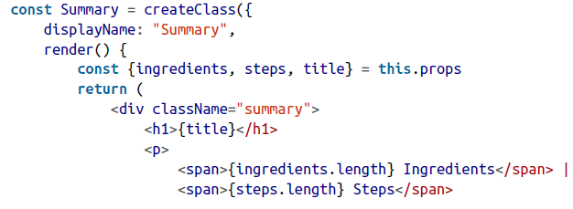
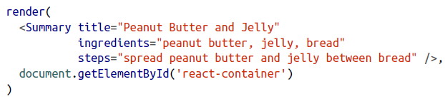
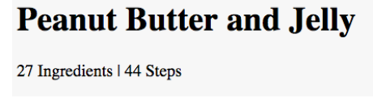
Validating Props with createClass
Consider the following two examples

Slide 79


Validating Props with createClass
The following example demonstrate the propTypes
propTypes are used to define the property types (strictly), raise an error while not belongs to given propTypes

Slide 80

Default Props
assign default values for properties
the default values you establish will be used if other values are not provided

Slide 81

Custom Property Validation
React’s built-in validators are great for making sure that your variables are required and typed correctly
Custom validation in React is implemented with a function

Slide 82
ES6 Classes and Stateless Functional Components
The class component
a stateful/container component
regular ES6 class that extends the component class of the React library
it controls how the state changes
the implementation of the component logic
The functional component
simply JavaScript functions
stateless or presentational components
returned data to be rendered to the DOM
with hooks, possible to implement of state and other features in React

Slide 83


ES6 Classes and Stateless Functional Components
ES6 classes, propTypes and defaultProps declarations are defined on the class instance, outside of the class body
With a stateless functional component, you also have the option of setting default properties directly in the function arguments

Slide 84
When I need to use ES6 Classes
If your component needs to access this, use ES6 Classes
If your components need lifecycle methods, use ES6 classes

Slide 85
ES6 Classes and Stateless Functional Components
Class Static Properties

Slide 86
Refs
Refs provide a way to access DOM nodes or React elements created in the render method
When to Use Refs
Managing focus, text selection, or media playback.
Triggering imperative animations.
Integrating with third-party DOM libraries.

Slide 87


Refs
Creating Refs
Accessing Refs
When the ref attribute is used on an HTML element, the ref created in the constructor with React.createRef()
not use the ref attribute on function components

Slide 88

Refs
Adding a Ref to a DOM Element
Define under the class
Explicitly focusing the text input
Attached in DOM element

Slide 89

Refs
Refs and Function Components

Slide 90
Refs
React State Management
Properties are immutable
State for managing data that will change within a component
User navigate, search, filter, select, add, update, and delete
After every interaction with an application
State might be changed
On state change, changes are reflected back to the user in the UI

Slide 91
State Management
Initializing State from Properties
State Within the Component Tree
Each React components can have their own state
React comes from building scalable applications
possible to group all state data in the root component
State data can be passed down the component tree via properties
data can be passed back up the tree to the root via two-way function binding
Referred as “single source of truth”.

Slide 92
State Management
Passing Properties Down the Component Tree
Presentational components are only concerned about the look in the application
render DOM elements or other presentational components
All data is sent to the components via properties and passed out of these components via callback functions
Presentational components only use props
Since we are removing state from this component, when a user changes the rating, that data will be passed out of this component via a callback function.

Slide 93

State Management

Slide 94

State Management
State in Reusable Components
create stateful UI components for distribution
reuse across many different applications

Slide 95

State Management
Passing Data Back Up the Component Tree
create stateful UI components for distribution
reuse across many different applications

Slide 96
Props vs. State
State | Props
The Data is passed from one component to another. | The Data is passed within the component only.
It is Immutable (cannot be modified). | It is Mutable ( can be modified).
Props can be used with state and functional components. | State can be used only with the state components/class component (Before 16.0).
Props are read-only. | State is both read and write.

Slide 97
Forms in react
HTML form elements work a bit differently from other DOM elements in React, because form elements naturally keep some internal state
Controlled Components
<input>, <textarea>, and <select> typically maintain their own state and update it based on user input
The textarea Tag
The select Tag
The file input Tag

Slide 98
Forms in react
Handling Multiple Inputs
Controlled Input Null Value

